Slide 1
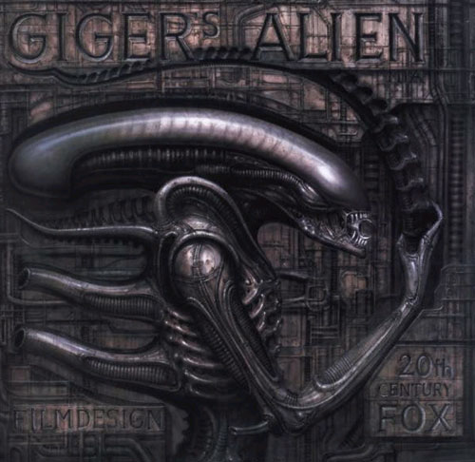
Week 6 Alien (Ridley Scott, 1979)
H.R. Giger, Design for Alien

Slide 2
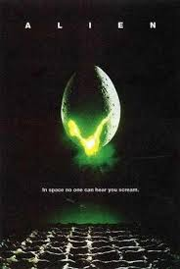
Alien (dir. Ridley Scott, 1979)
Critical reception initially mixed
Now regarded as a classic
Box office success
Academy Awards for Visual Effects, Art Direction
First lead for Sigourney Weaver

Slide 3
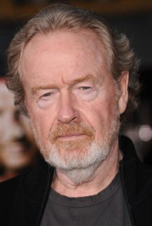
Ridley Scott (b. 1937, England)
Select Filmography:
Alien (1979)
Blade Runner (1982)
Legend (1985)
Thelma & Louise (1991)
Gladiator (2000)
Prometheus (2012)
Alien: Covenant (2017)
If you spoil this I will end you

Slide 4
Signal Question
Alien is a classic of “science fiction,” and it deals with a common theme in the genre: the role of science and/or technology in relation to humanity/ monstrosity (cf. Frankenstein, The Fly. What might the film be trying to tell us about science and/or technology? What part does the “monster” play in this theme?

Slide 5
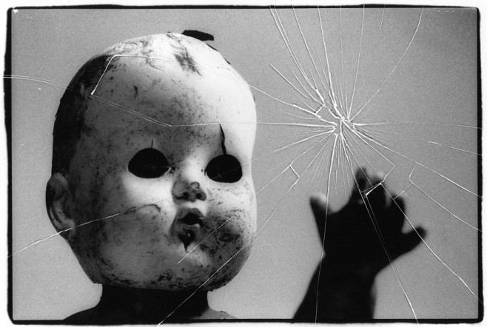
The Uncanny
That which is both familiar and unfamiliar
Produces discomfort, cognitive dissonance
Related to anxiety, apprehension
Ambiguity between animate and inanimate
Examples: dolls, wax figures, automatons, corpses, deja vu

Slide 6
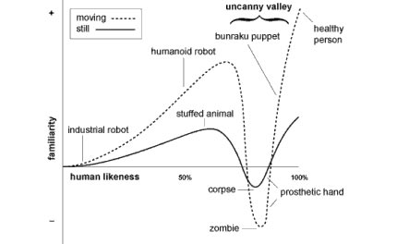
Masahiro Mori, “The Uncanny Valley”

Slide 7
The Freudian “Uncanny”
When we find something to be "uncanny," it's because it reminds us of our own repressed desires. In the repetition or reoccurrence of that which has been ‘repressed,’ we encounter the strangeness of something that is both familiar and attractive (in the unconscious) and strange and repulsive (in the conscious mind). It mixes attraction and repulsion, familiarity and strangeness. It derives its terror not from something externally alien or unknown but—on the contrary—from something strangely familiar which defeats our efforts to separate ourselves from it.

Slide 8
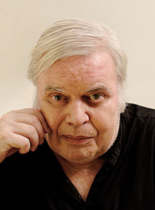
H.R. Giger (1940-2014)
Swiss painter, sculptor, designer
Designed all aspects of the “alien” and parts of the set

Slide 9
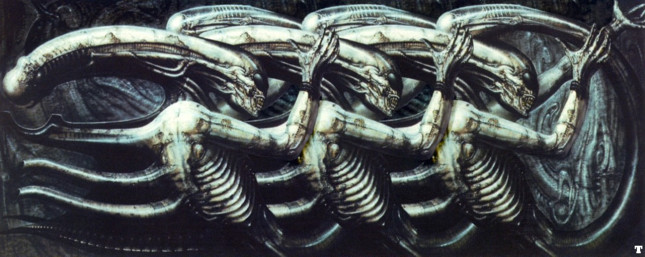
H.R. Giger
Necronom IV (Print, 1976)

Slide 10
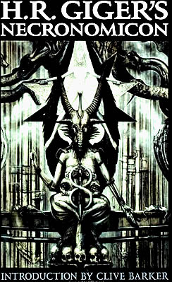
H.R. Giger’s Necronomicon (1977)
Named for H.P. Lovecraft’s fictitious Necronomicon
Shown to Ridley Scott to help recruit Giger

Slide 11
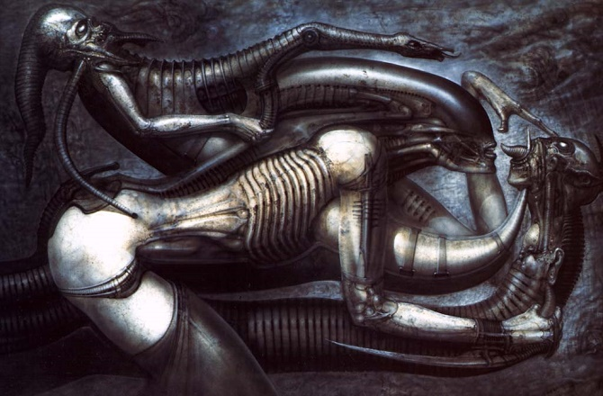
H.R. Giger, Necronomicon

Slide 12
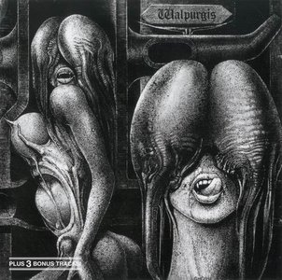
H.R. Giger, Necronomicon

Slide 13
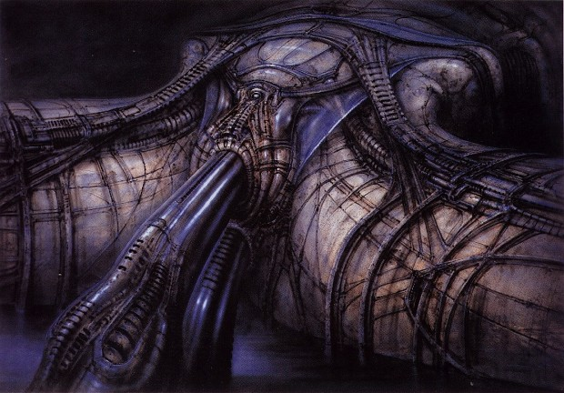
H.R. Giger, Necronomicon

Slide 14
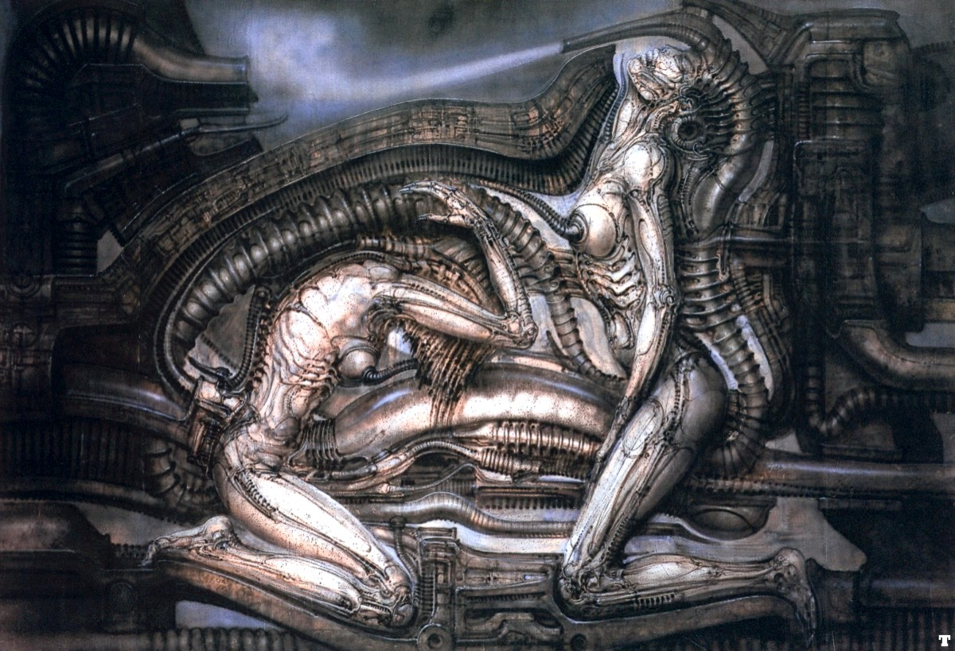
H.R. Giger, Necronomicon

Slide 15
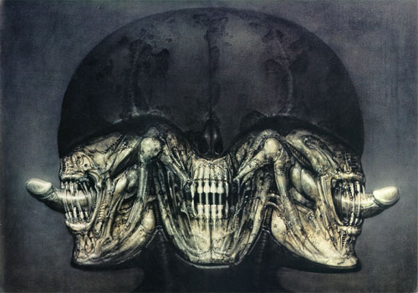
H.R. Giger, Necronomicon

Slide 16
Signal Question
How would you relate these images, and the imagery of the alien in the film, to the idea of the uncanny? What about the abject?

Slide 17
Cohen’s “Monster Theses”
The Monster’s Body Is a Cultural Body
The Monster Always Escapes
The Monster is the Harbinger of Category Crisis
The Monster Dwells at the Gates of Difference
The Monster Polices the Borders of the Possible
Fear of the Monster is Really a Kind of Desire
The Monster Stands at the Threshold… of Becoming

Slide 18
“Category Crisis”
Example: on Alien (dir. Ridley Scott, 1979)
“It is a Linnean nightmare, defying every natural law of evolution; by turns bivalve, crustacean, reptilian, and humanoid. It seems capable of lying dormant within its egg indefinitely. It sheds its skin like a snake, its carapace like an arthropod. It desposts its young into other species like a wasp…. It responds according to Lamarckian and Darwinian principles.” —critic Harvey Greenberg

Slide 19
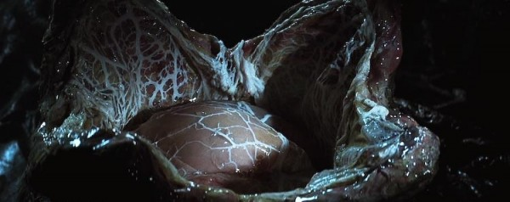
Thesis 3: The Monster is the Harbinger of Category Crisis

Slide 20
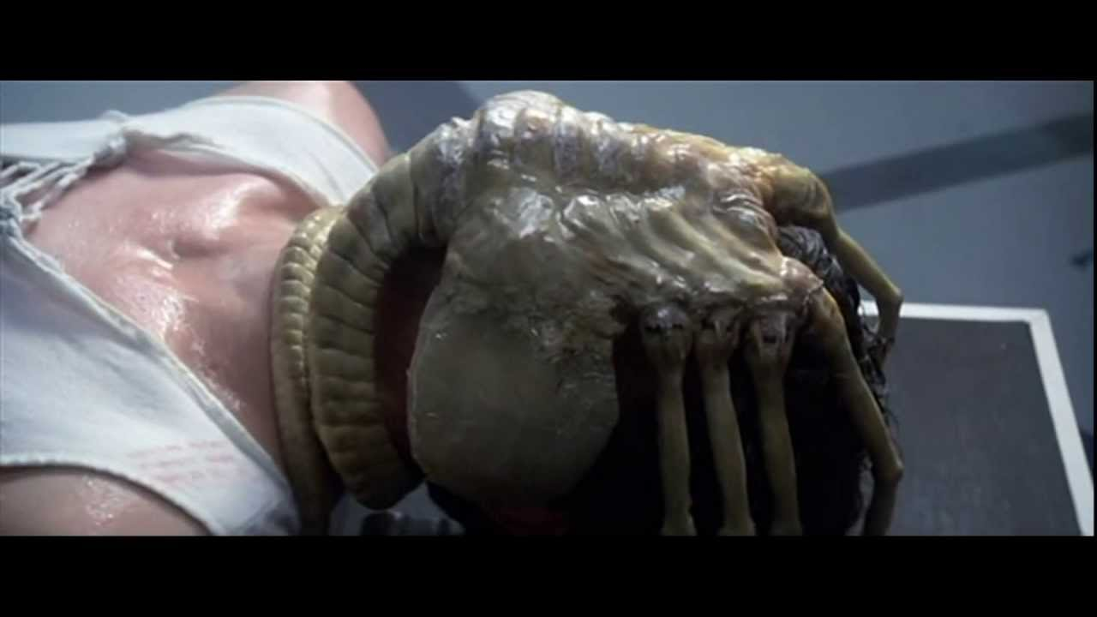
Thesis 3: The Monster is the Harbinger of Category Crisis

Slide 21
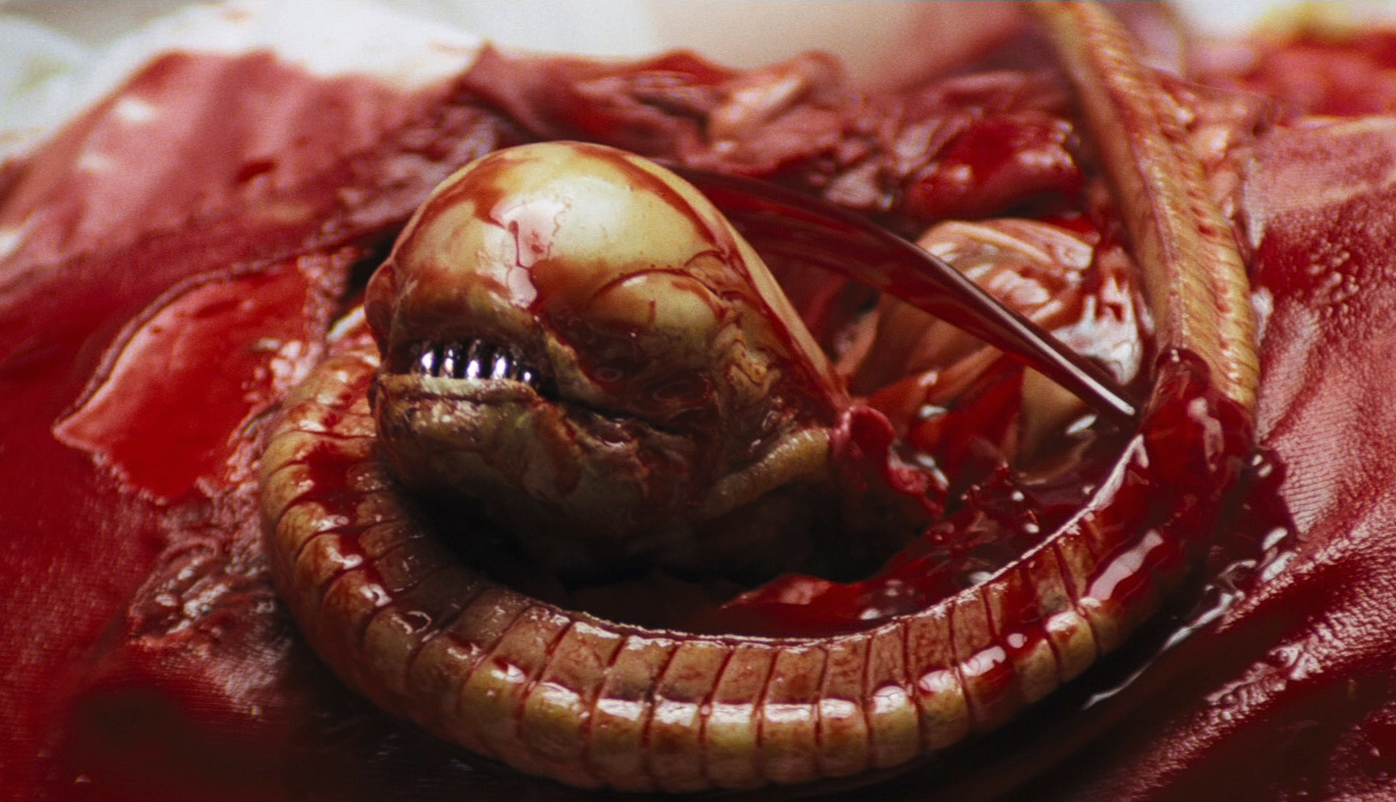
Thesis 3: The Monster is the Harbinger of Category Crisis

Slide 22
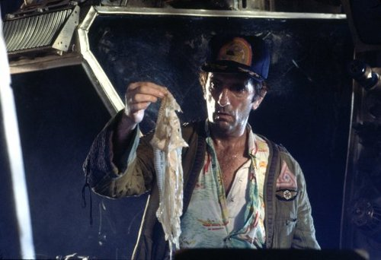
Thesis 3: The Monster is the Harbinger of Category Crisis

Slide 23
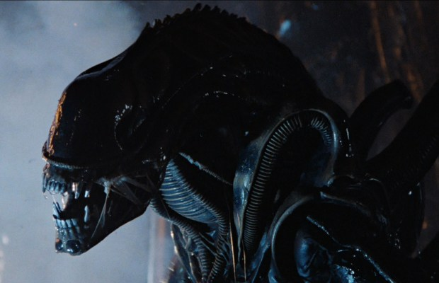
Thesis 3: The Monster is the Harbinger of Category Crisis

Slide 24
The Powers of Horror: Maternity
“Woman’s birth-giving function has provided the horror film with an important source of many of its most horrific images—its intrauterine iconography, the parthenogenetic mother, evocations of the uncanny and images of alien births.” (Barbara Creed)
[Parthenogenesis: “reproduction by development of an unfertilized usually female gamete that occurs especially among lower plants and invertebrate animals” (Webster)]

Slide 25
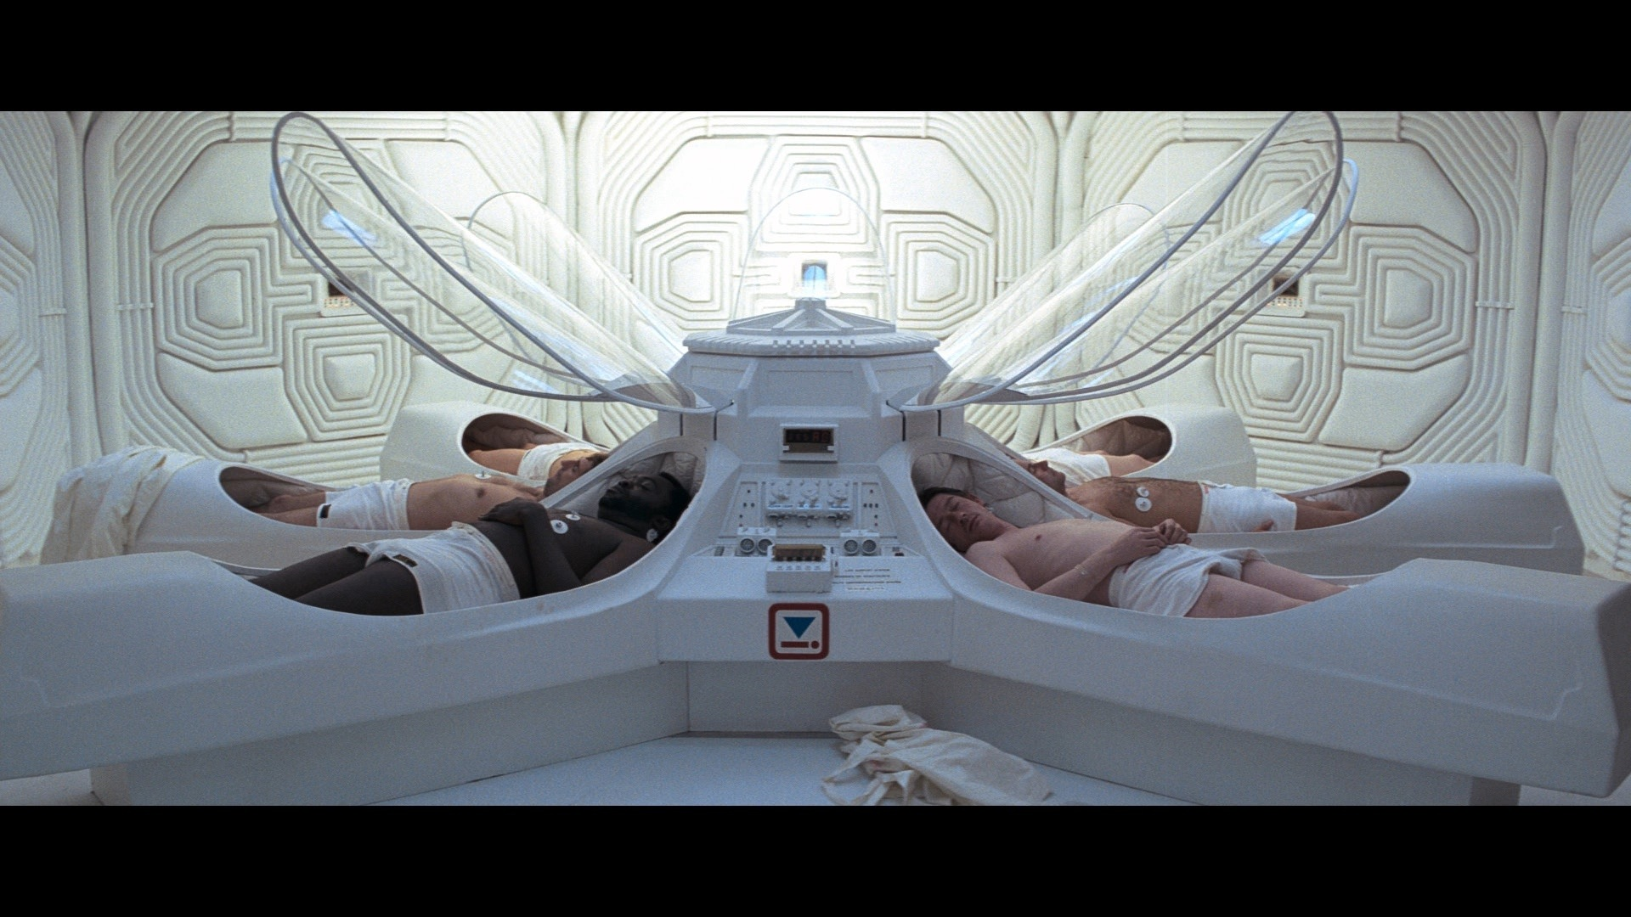
Alien (1979)

Slide 26
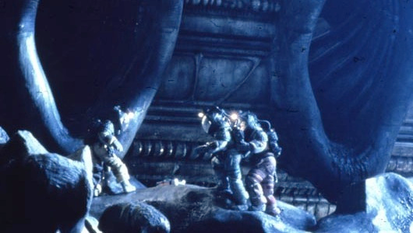
“The second birth scene – more a conception – involves two men and a woman collectively imaged as three clumsy sperm-like figures entering the vaginal opening between the upstretched ‘legs’ of an alien spaceship. Entering a corridor that exudes the ooze of biology, they establish an effective visual trope: the confusion of organic and mechanical textures, which gives the alien his camouflage.”
–Critic James Kavanagh

Slide 27
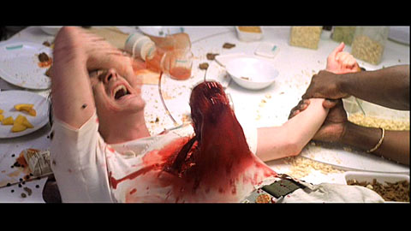
Alien (1979)

Slide 28
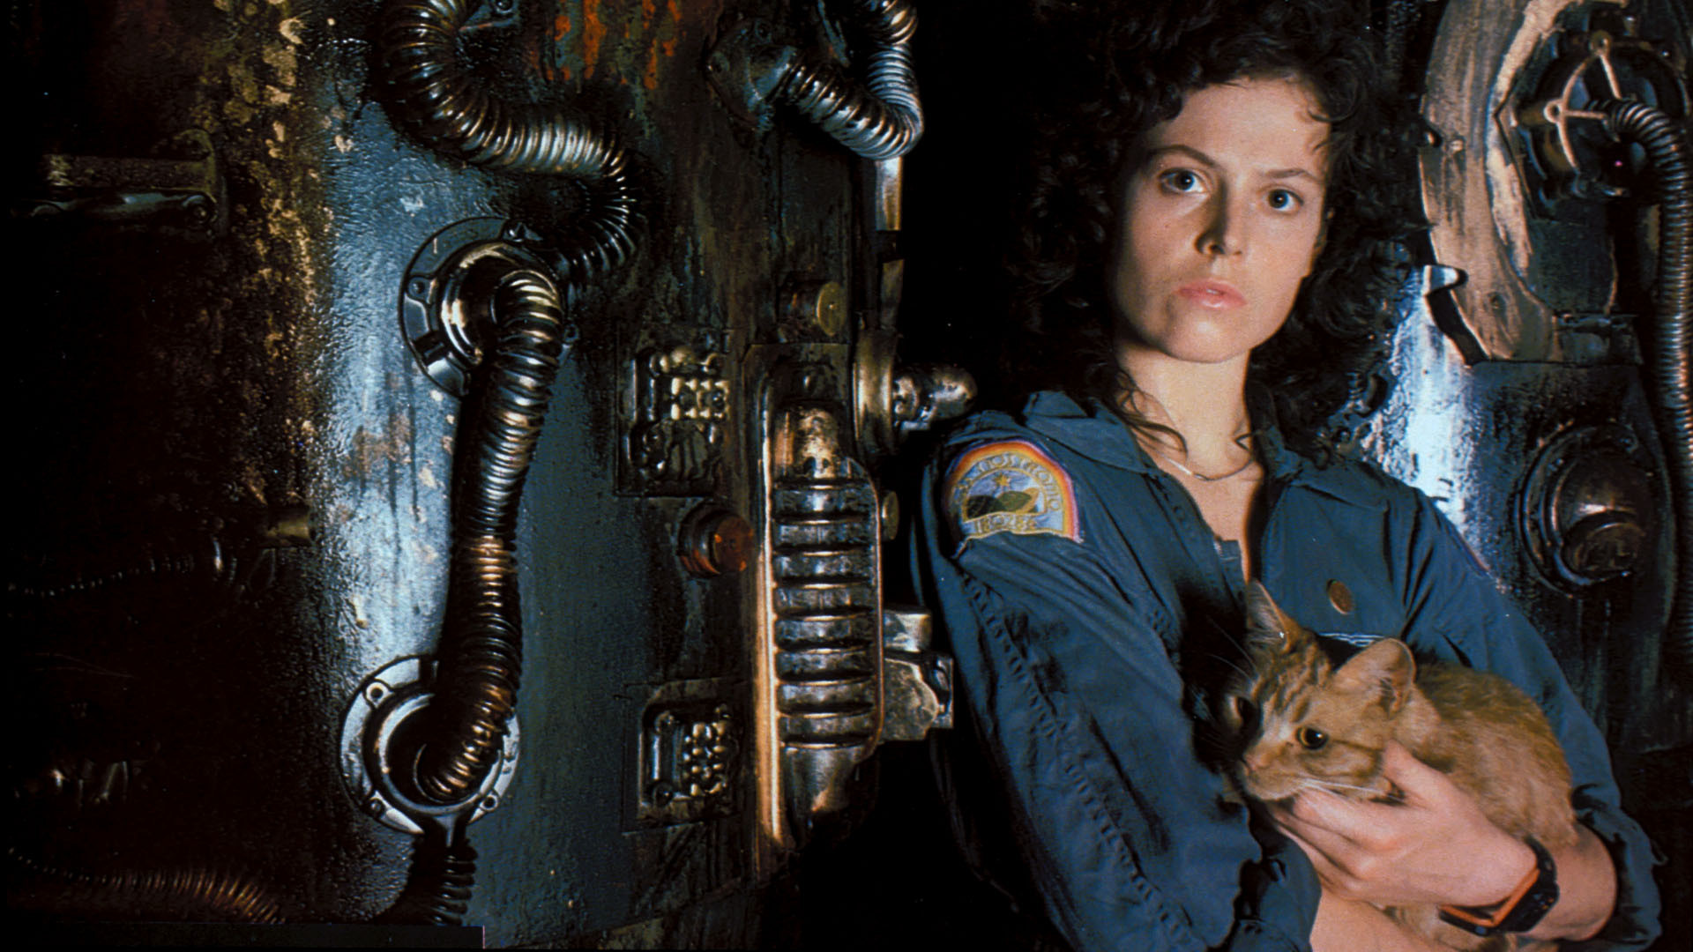
Aliens (1979)

Slide 29
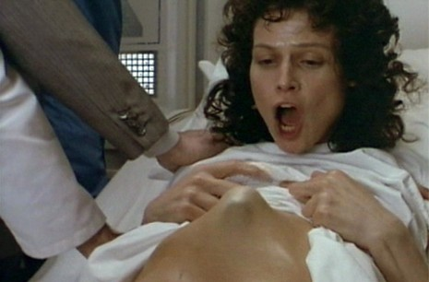
Aliens (1986)

Slide 30
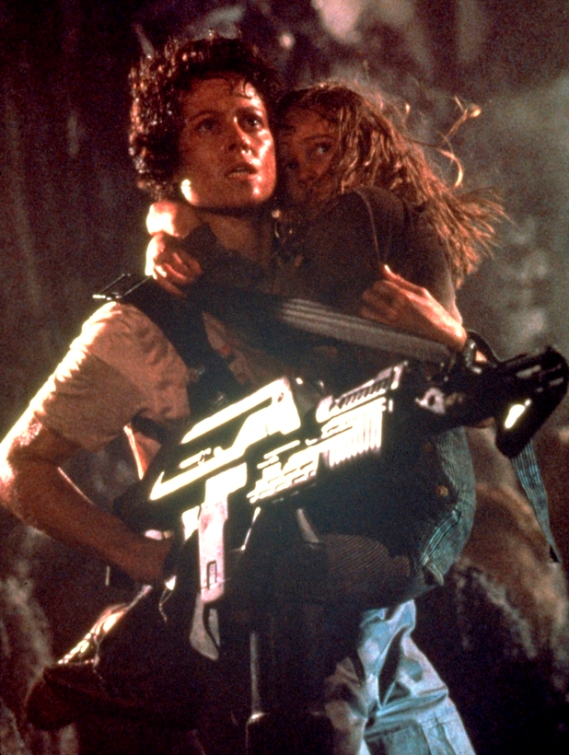
Aliens (1986)

Slide 31
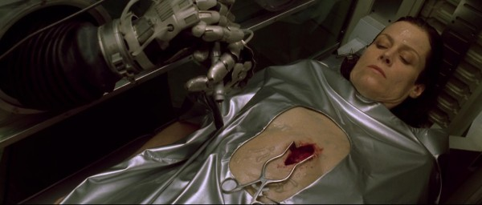
Alien: Resurrection (1997)

Slide 32
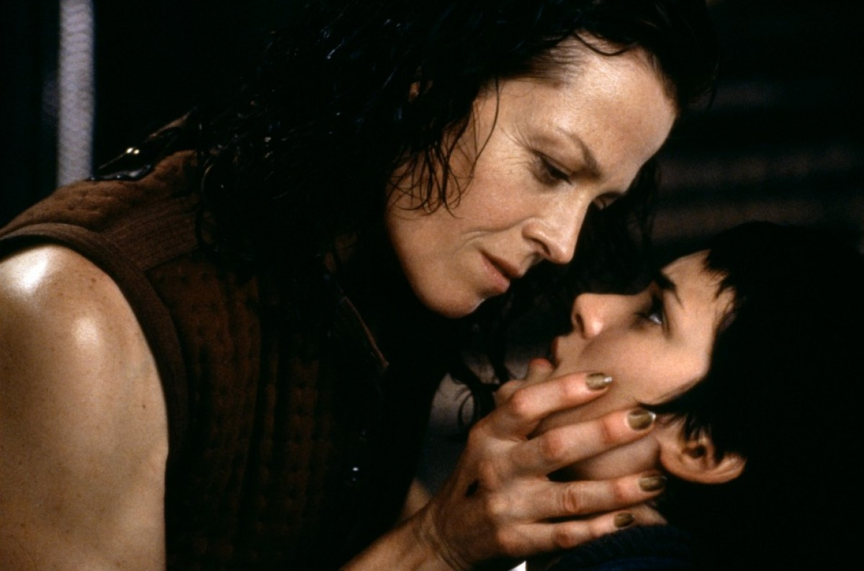
Alien: Resurrection (1997)

Slide 33
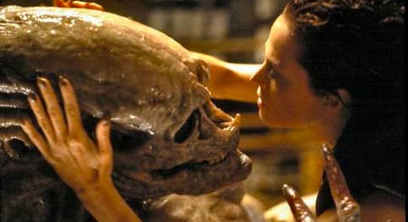
Alien: Resurrection (1997)

Slide 34
The Powers of Horror: Maternity
“Virtually all horror texts represent the monstrous-feminine in relation to Kristeva’s notion of maternal authority and the mapping of the self’s clean and proper body. Images of blood, vomit, pus, shit, etc., are central to our culturally/socially constructed notions of the horrific.”

Slide 35
The Powers of Horror: Maternity
“Viewing the horror film signifies a desire not only for perverse pleasure . . . But also a desire, once having been filled with perversity, taken pleasure in perversity, to throw up, through out, eject the abject (from the safety of the spectator’s seat.”
“The horror film attempts to bring about a confrontation with the abject (the corpse, bodily wastes, the monstrous-feminine) in order finally to eject the abject and redraw the boundaries between the human and the non-human.”

Slide 36
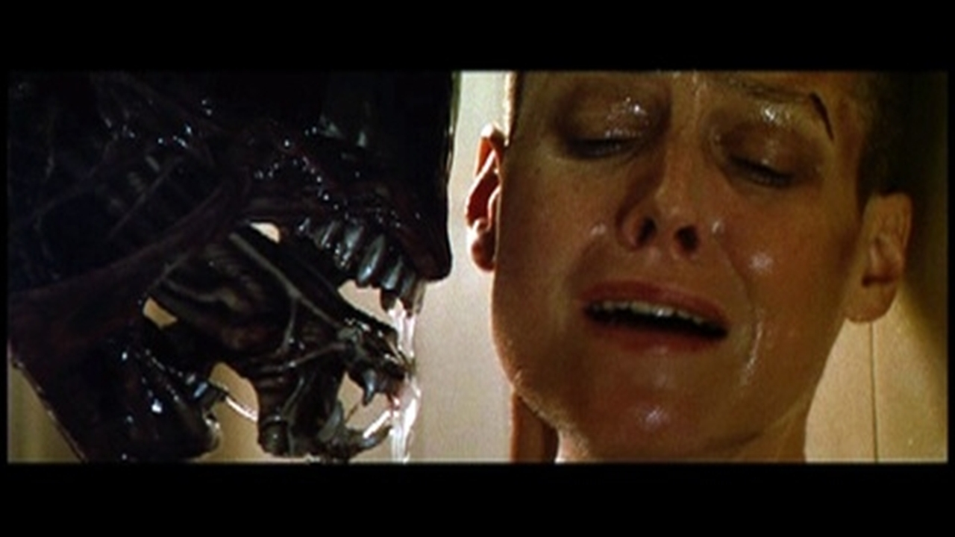
Genital Imagery in Science Fiction…
http://www.buzzfeed.com/alisonwillmore/19-movie-monsters-that-look-like-penises-and-vaginas#.ytYvoR3xk

Slide 37
Signal Question
Alien seems to use maternal and reproductive imagery as a source or horror; at the same time, it presents a strong (maternal) female character in opposition to these forces. Are these aspects of the maternal presented differently? How so? Does the film have a position on this?

Slide 38
“The alien, which is fond of womb-like and vaginal-like spaces, is distinctly phallic, and it attacks Ripley, like a fantasy rapist, while she is undressing. But the alien is also equipped with a rather impressive set of vaginal teeth. It is born of eggs, and it continually gives birth to itself, once in a gory evocation of childbirth at the dining room table. In this respect, the alien is a potent expression of male terror at female sexuality and at castrating females in general.”
--Critic Judith Newton

